Slide 1

Truss decomposition in massive networks
VLDB 2012
Tianzhu Wei
2016 – 12 - 5
Notes:
香港中文大学
新加坡南洋理工大学

Slide 2
Contents
Problem definition
Exist solution
Our solution
Experiments
Conclusion

Slide 3

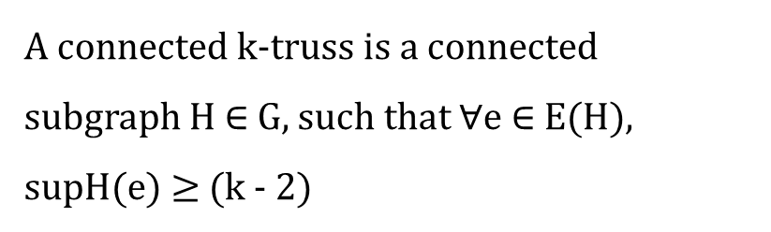

Problem definition
t
The support of an edge e(u , v) ∈ G
v2
v5
p1
$$\sup_{G}(e)$$
$$=|\left\{△_{uvw}:w∈V\right\}|$$
P2
q1
v1
v3
Conneceted K-Truss
A connected k-truss is a connected subgraph H $∈$ G, such that $∀$e $∈$ E(H), supH(e) $≥$ (k - 2)
q2
v4
P3
4 - Truss

Slide 4


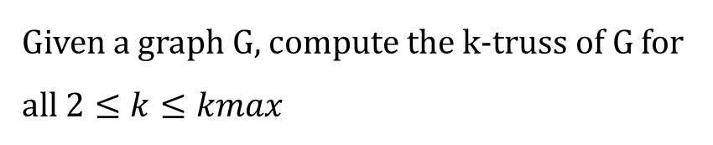

Problem definition
t
$$\text{The} \text{trussness} \text{of} \text{a} edge$$
v2
v5
p1
$$τ\left(e\right)=\max_{H⊆G\&e∈E\left(H\right)}\{τ\left(H\right)\}$$
$$τ\left(e\right)=4$$
P2
q1
v1
v3
q3
Truss Decomposition
Given a graph G, compute the k-truss of G for
all $2≤k≤kmax$
q2
v4
P3

Slide 5








Exist Solution
In-Memory Algorithm
a
e
f
j
$$compute support\left(e\right)$$
3
1
2
3
2
2
2
$$support\left(e\left(a,b\right)\right)=| nb\left(a\right)⋂nb\left(b\right) |$$
=3
3
3
4
2
2
3
d
1
g
0
3
3
2
$$nb\left(a\right)=\{e,d,b,c\}$$
1
2
i
b
h
3
0
$$nb\left(b\right)=\{a,e,d,c\}$$
3
1
1
0
1
1
0
$$Remove edge$$
c
L
k
$$remove e :\sup\left(e\right)<(k−2)$$
using a queue
3-Truss
$$k=3$$
$$k=4$$

Slide 6

Exist Solution
In-Memory Algorithm
a
e
f
j
$$compute support\left(e\right)$$
3
2
3
2
2
$$support\left(e\left(a,b\right)\right)=| nb\left(a\right)⋂nb\left(b\right) |$$
=3
3
3
3
2
2
d
$$nb\left(a\right)=\{e,d,b,c\}$$
3
3
i
b
h
2
$$nb\left(b\right)=\{a,e,d,c\}$$
3
3
$$Remove edge$$
c
$$remove e :\sup\left(e\right)<(k−2)$$
4-Truss
$$k=3$$
$$k=4$$
$$k=…$$

Slide 7






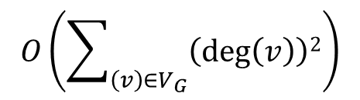
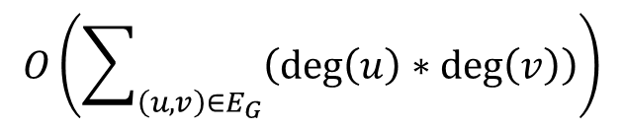
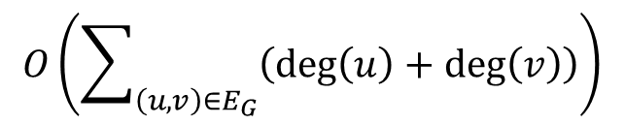

Exist Solution
In-Memory Algorithm
a
e
f
j
$$compute support\left(e\right)$$
$$support\left(e\left(a,b\right)\right)=| nb\left(a\right)⋂nb\left(b\right) |$$
d
g
$$O\left(\sum_{\left(u,v\right)∈E_{G}}{\left(\deg\left(u\right)∗\deg\left(v\right)\right)}\right)$$
b
i
h
$$Remove edge$$
$$Updating the adjacency lists u and v$$
c
L
k
$$for each dege e(u,v)$$
$$O(\deg\left(u\right)+deg⁡(v))$$
$$O\left(\sum_{\left(u,v\right)∈E_{G}}{\left(\deg\left(u\right)+\deg\left(v\right)\right)}\right)$$
$$O\left(\sum_{\left(v\right)∈V_{G}}{\left(\deg\left(v\right)\right)2}\right)$$
$$for all deges e(u,v)$$

Slide 8
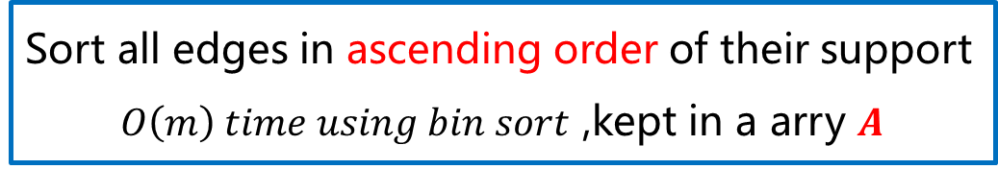

OurSolution
An Improved Algorithm
Comupte the support for edges in G
$$O(m^{1.5})$$
Sort all edges in ascending order of their support
$O\left(m\right) time using bin sort$ ,kept in a arry $Α$
Remove edges
But not explicitly remove

Slide 9











OurSolution
An Improved Algorithm
a
e
f
j
3
1
2
$$remove e :\sup\left(e\right)≤(k−2)$$
k=2
3
2
2
2
3
3
4
2
2
3
d
g
2
$$Φ_{2}=\{(k,i)\}$$
3
3
1
1
2
i
b
h
k-class
$$\deg\left(k\right)=3$$
k=3
$$<$$
$$\deg\left(d\right)=7$$
3
1
3
1
0
$$define as \{e : ∈E_{G} , φ\left(e\right)=k\}$$
1
1
0
$$\operatorname{nb}\left(k\right)=\{d,g,i\}$$
c
L
k
Efficient ?
$$if (d,w)∈E_{G}{ (w∈nb(k))}$$
not explicitly remove
$$\sup\left(d,g\right)←(\sup\left(d,g\right)−1)$$
Reorder
$$\sup\left(k,g\right)←(\sup\left(k,g\right)−1)$$
A
$$(i,k)$$ | $$(d,k)$$ | $$(k,g)$$ | ... | $$(d,g)$$ | ... | $$(a,c)$$ | $$(e,d)$$
$$Φ_{3}=\{(d,k)\}$$
Notes:
K-class 就是指 所指边最大的 trussness

Slide 10


OurSolution
An Improved Algorithm
$$if (d,w)∈E_{G}{ (w∈nb(k))}$$
Reorder
Bin
0 | $$1$$ | $$2$$ | 3 | 4
A
$$\left(i,k\right)0$$ | $$\left(d,k\right)1$$ | $(k,g)$1 | ... | $$\left(d,g\right)2$$ | ... | $(a,c)$3 | $$\left(e,d\right)4$$
Hashtable
$$(i,k)$$ | $$(d,k)$$ | $$(k,g)$$ | ... | $$(d,g)$$ | ... | $$(a,c)$$ | $$(e,d)$$

Slide 11
OurSolution
Bottom-up truss decomposition
Top-down truss decomposition

Slide 12
a
OurSolution
Bottom-up
neighborhood subgraph
internal edges
external edges
NS(P1)
NS(P2)
NS(P3)

Slide 13
OurSolution
Bottom-up
a
e
f
j
Lower-bounding
b
d
g
h
i
Remove 2-class
j
c
L
k
4
G
4
4
h
4
i
f
4
j
4
4
4
2
g
h
4
i
2
2
d
2
k
Gnew
P3

Slide 14
OurSolution
Bottom-up
a
e
f
j
Lower-bounding
b
d
g
h
i
e
f
j
c
L
k
4
G
4
3
3
2
d
g
h
4
i
e
f
3
d
g
Gnew
P2

Slide 15
OurSolution
Bottom-up
a
e
f
i
Lower-bounding
b
d
g
h
j
a
e
f
j
c
l
k
4
G
4
b
d
g
h
4
i
a
e
5
5
b
d
c
5
g
c
l
Gnew
P1

Slide 16


3
4
OurSolution
Bottom-up
a
e
f
j
3
3
4
4
5
5
4
4
5
3
3
let U_{k} = {v : v ∈ VG_{new} , ∃e =(u, v) ∈ EG_{new} , s.t. φ(e) ≤ k}
b
d
g
h
4
i
5
3
3
3
3
k=3
Add sup(e) <=k-2 to $Φ_{3}$,and remove
c
l
k
Gnew
$$Φ_{3}=\{ \left(d,L\right),\left(d,k\right), \left(g,h\right),(g,L)\}$$
$$Φ_{3}=\{ \left(d,L\right),\left(d,k\right), \left(g,h\right),\left(g,L\right),\left(d,g\right),(f,g)\}$$
2
a
e
f
j
2
1
2
4
2
1
1
b
d
g
h
i
1
1
1
1
c
L
k
NS & compute sup(e)

Slide 17
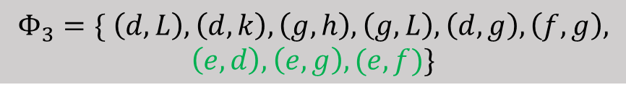
3
4
OurSolution
Bottom-up
a
e
f
j
3
3
4
4
5
5
4
4
5
3
3
let U_{k} = {v : v ∈ VG_{new} , ∃e =(u, v) ∈ EG_{new} , s.t. φ(e) ≤ k}
b
d
g
h
4
i
5
3
3
3
3
k=3
Add sup(e) <=k-2 to $Φ_{3}$,and remove
c
l
k
Gnew
$$Φ_{3}=\{ \left(d,L\right),\left(d,k\right), \left(g,h\right),(g,L)\}$$
$$Φ_{3}=\{ \left(d,L\right),\left(d,k\right), \left(g,h\right),\left(g,L\right),\left(d,g\right),(f,g)\}$$
$$Φ_{3}=\{ \left(d,L\right),\left(d,k\right), \left(g,h\right),\left(g,L\right),\left(d,g\right),\left(f,g\right),$$
$$\left(e,d\right),\left(e,g\right),(e,f)\}$$
a
e
1
f
j
1
3
Remove these internal edges from Gnew
b
d
g
h
i
c
L
k
NS & compute sup(e)

Slide 18
OurSolution
Bottom-up truss decomposition
Top-down truss decomposition
Notes:
处理大图的方法

Slide 19
OurSolution
Top-down
a
e
f
j
computes the Top-t k classes
2
4
2
3
3
3
1
Upper Bounding
b
d
g
h
i
3
1
1
1
ψ( e ) = (min{sup(e) ,x_{u}, x_{v} } + 2)
1
c
l
k
x_{u} :there are x_{u} edges incident to u, excluding e,
with support at least x_{u}
ψ( d , g ) = (min{3 ,3, 2 } + 2) = 4
Notes:
先用之前的方法求解出sup（e）
先分解

Slide 20
OurSolution
Top-down
5
3
4
a
e
f
j
Kmax=5 k=5
4
4
4
5
5
4
5
4
3
U_{k} = {v : v ∈ VG_{new} , ∃e =(u, v) ∈ EG_{new} , ψ(e) $≥$ k}
b
d
g
h
i
4
5
3
3
3
0
3
a
e
f
5
3
c
l
k
3
1
4
Gnew
1
3
b
d
g
Sup(e)
3
0
0
Remove internal e :sup (e) <( 5 − 2)
3
c
l
k
$$output internal edges into Φ_{5}=\{…\}$$

Slide 21
OurSolution
Top-down
5
3
4
a
e
f
j
Kmax=5 k=5
4
4
4
5
5
4
5
4
3
U_{k} = {v : v ∈ VG_{new} , ∃e =(u, v) ∈ EG_{new} , ψ(e) $≥$ k}
b
d
g
h
i
4
5
3
3
3
3
a
e
5
3
c
l
k
3
4
Gnew
3
b
d
Sup(e)
3
Remove internal e :sup (e) <( 5 − 2)
3
c
Remove any edge e ∈ Tj (j >= 5) from Gnew
$$output internal edges into Φ_{5}=\{…\}$$

Slide 22
OurSolution
Top-down
3
4
e
f
j
Kmax=5 k=4
4
4
4
5
4
4
3
U_{k} = {v : v ∈ VG_{new} , ∃e =(u, v) ∈ EG_{new} , ψ(e) $≥$ k}
d
g
h
i
4
3
3
3
3
2
l
k
e
f
j
1
Gnew
0
2
1
2
Sup(e)
d
g
h
2
i
1
Remove internal e :sup (e) <( 4 − 2)
Remove any edge e ∈ Tj (j >= 4) from Gnew
$$output internal edges into Φ_{4}=\{…\}$$

Slide 23
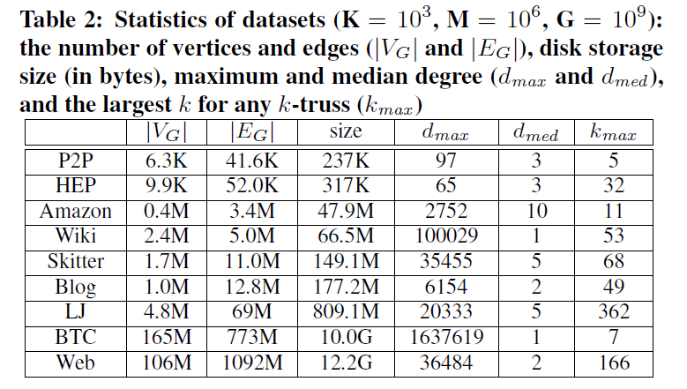
Experiments

Slide 24
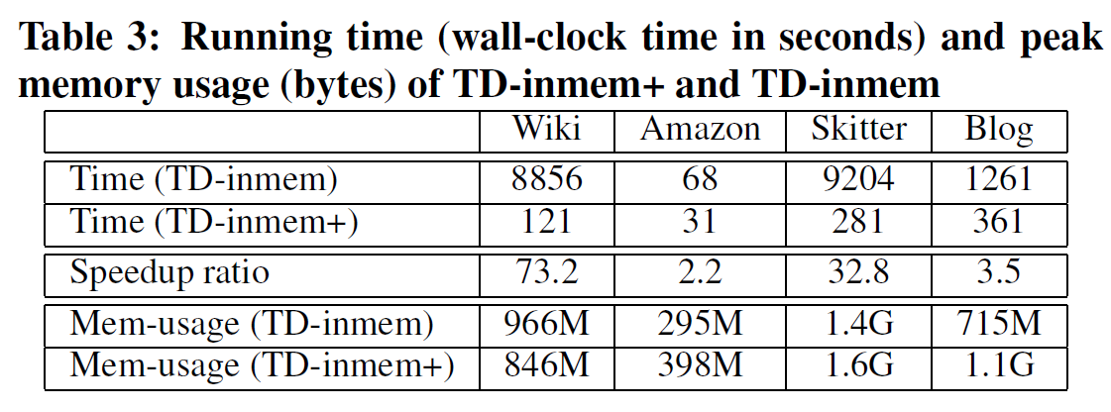
Experiments
Notes:
TD-inmem+ 是作者提出的在内存中的改进方法
TD-inmem 是之前常用的 Truss 分解方法
前两行为运行时间
第三行为加速比，作者的方法比之前的方法快了多少
第四行第五行是两种方法的占用内存的对比

Slide 25
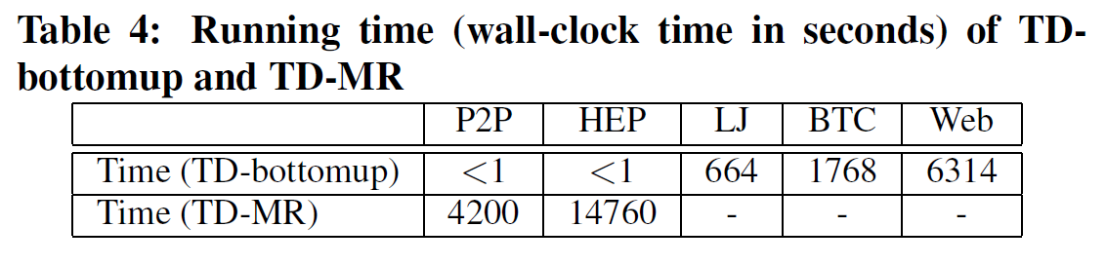
Experiments
Notes:
第一个是作者方法 自底向上
第二个目前已经存在的方法作为对比

Slide 26
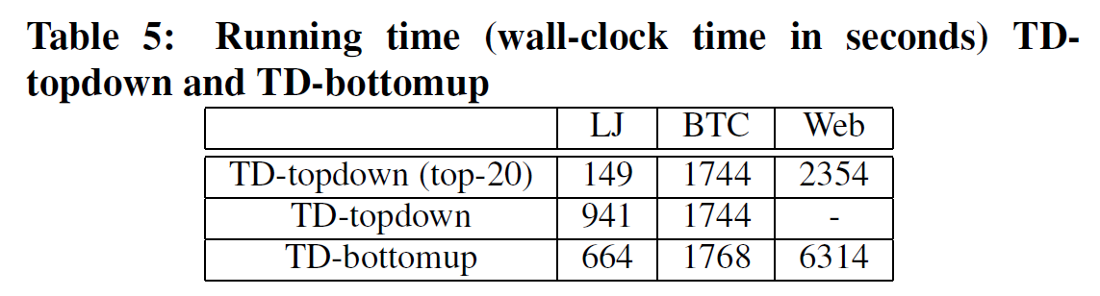
Experiments
Notes:
将所有结点按度的大小从大到小进行排列，并且等分了5份，横坐标分别与等分的5部分相对应

Slide 27
Conclusion
Truss Decomposition
TD
In memory
TD +
Bottom-up approach
Lower bounding
I/O Efficient Decomposition
Top-down approach
Upper bounding
Top-t k-class

Slide 28
Thanks

